Slide 1
Linear Algebra
Lecture 38

Slide 2
Linear Algebra
Lecture 38

Slide 3
Segment VI

Slide 4
Orthogonality and
Least Squares

Slide 5
Inner Product,
Length and
Orthogonality

Slide 6
Inner Product
If u and v are vectors in R^{n}, then we regard u and v as n x 1 matrices. The transpose u^{T} is a 1 x n matrix, and the matrix product u^{T}v is a 1 x 1 matrix, which we write as a single real number (a scalar) without brackets. …

Slide 7
Continued
The number u^{T}v is called the inner product of u and v, and often it is written as u.v.
This inner product, is also referred to as a dot product.
…

Slide 8
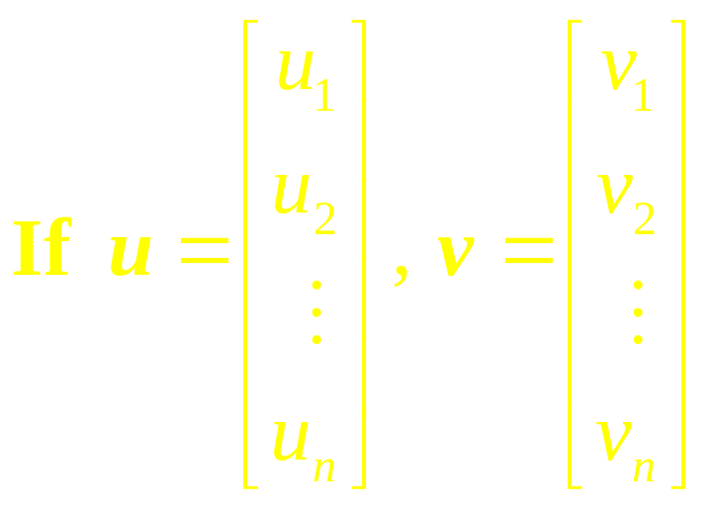
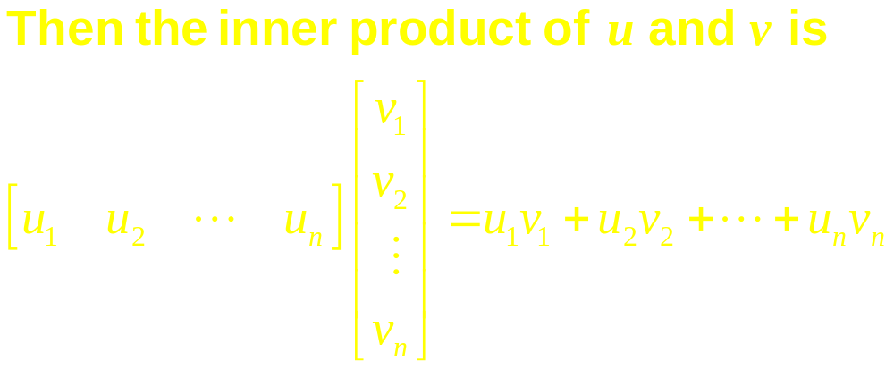
Continued

Slide 9
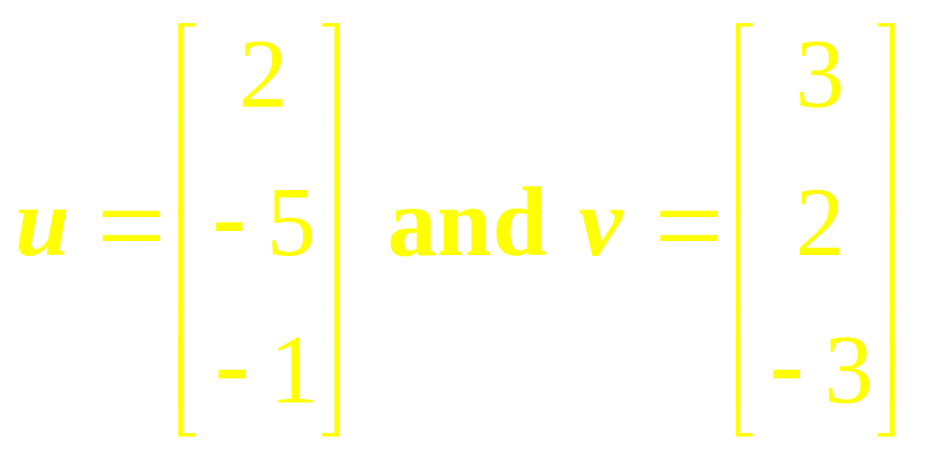
Example 1
Compute u.v and v.u when
…

Slide 10
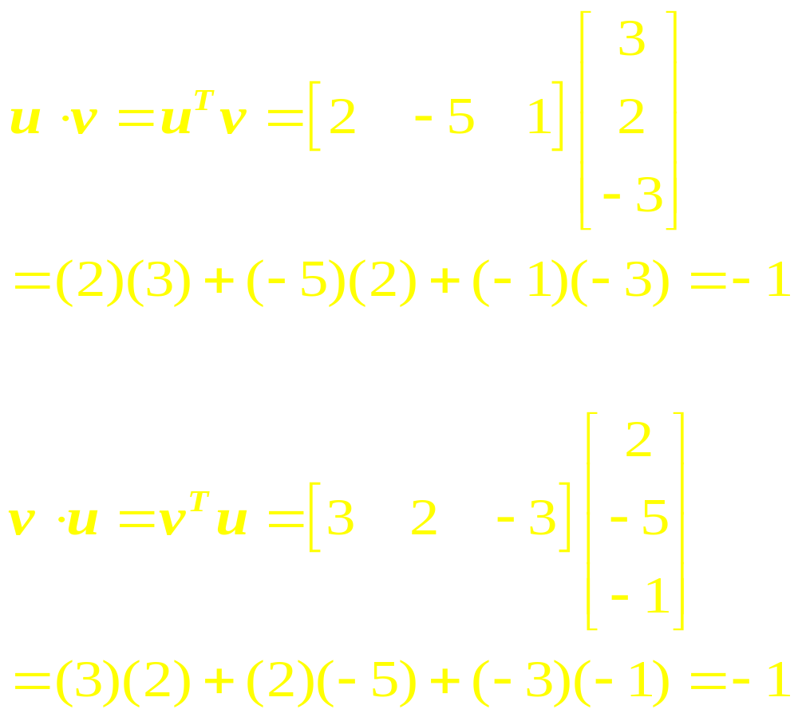
Solution

Slide 11
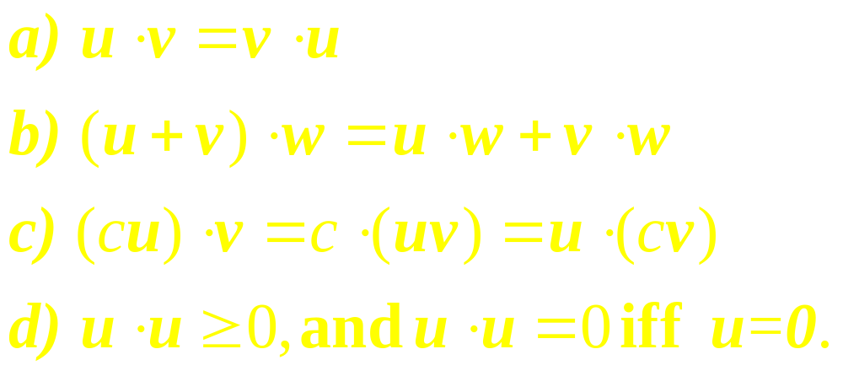
Theorem
Let u, v and w be vectors in R^{n}, and let c be a scalar. Then

Slide 12
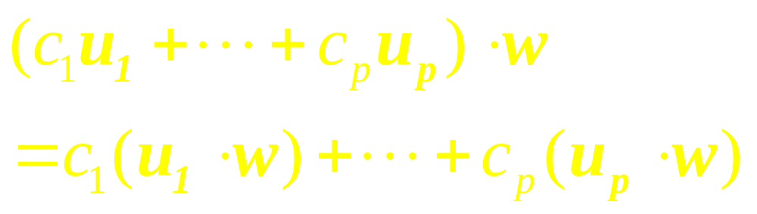
Observe

Slide 13
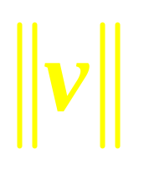
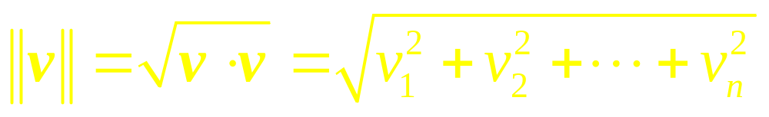
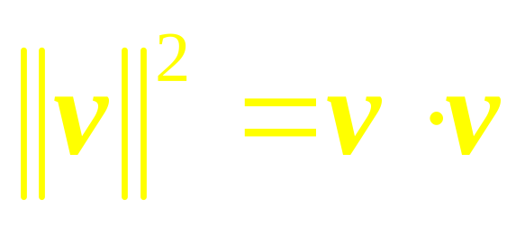
Definition
The length (or norm) of v is the nonnegative scalar
defined by

Slide 14

Note
For any scalar c,

Slide 15
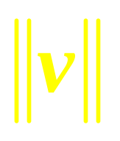
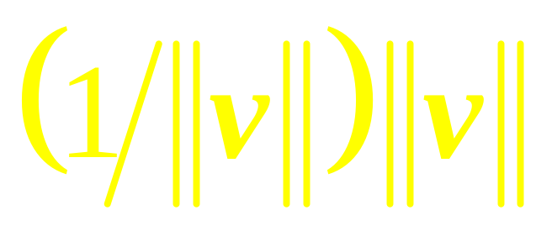
Unit Vector
A vector whose length is 1.
If we divide a nonzero vector v by its length , we obtain a unit vector u because the length of u is
…

Slide 16
Continued
The process of creating u from v is sometimes called normalizing v, and we say that u is in the same direction as v.

Slide 17
Example 2
Let v = (1,–2, 2, 0). Find a unit vector u in the same direction as v.

Slide 18
Example 3
Let W be the subspace of R² spanned by
x = (2/3, 1).
Find a unit vector z that is a basis for W.

Slide 19
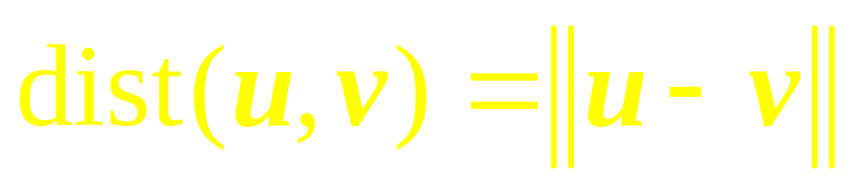
Definition
For u and v in R^{n}, the distance between u and v, written as dist(u, v), is the length of the vector u – v. That is,

Slide 20
Example 4
Compute the distance between the vectors
u = (7, 1) and v = (3, 2).
…

Slide 21
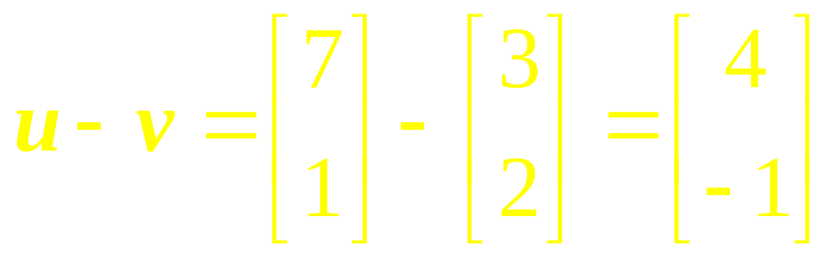
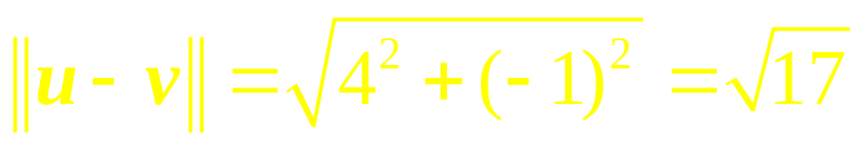
Solution

Slide 22
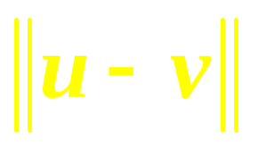

Continued
x₂
v
u
x₁
-v
u-v
Figure 4 The distance between u and v

Slide 23
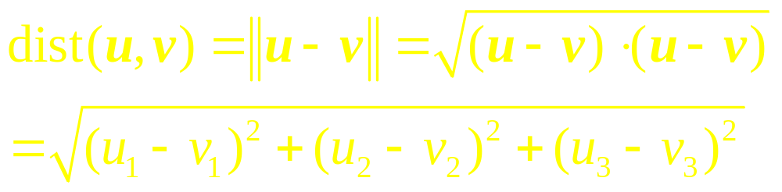
Example 5
If u = (u₁, u₂, u₃) and
v = (v₁, v₂, v₃), then

Slide 24
Orthogonal
Vectors

Slide 25
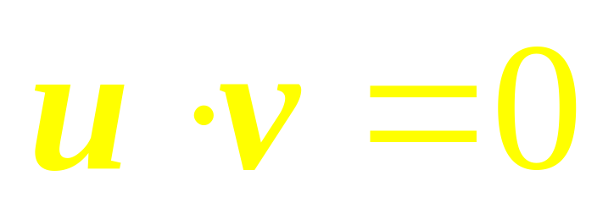
Definition
Two vectors u and v in R^{n} are orthogonal (to each other) if

Slide 26
Note
The zero vector is orthogonal to every vector in R^{n} because 0^{T}. v = 0 for all v.

Slide 27
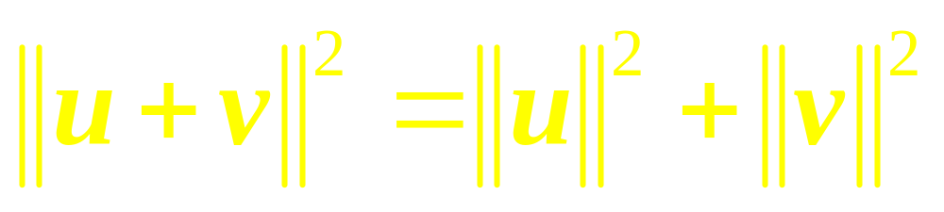
Pythagorean Theorem
Two vectors u and v are orthogonal if and only if

Slide 28
Orthogonal
Complements
If a vector z is orthogonal to every vector in a subspace W of R^{n}, then z is said to be orthogonal to W. …

Slide 29
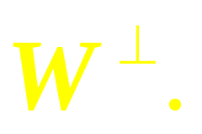
Continued
The set of all vectors z that are orthogonal to W is called the orthogonal complement of W and is denoted by

Slide 30
Example 6

Slide 31
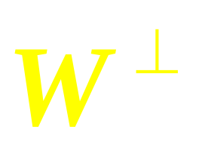
Remarks
(1) A vector x is in if and only if x is orthogonal to every vector in a set that spans W.
(2) is a subspace of R^{n}.

Slide 32
Theorem 3

Slide 33
Angles in Two and
Three Dimensions
R² and R³

Slide 34
Linear Algebra
Lecture 38

